Slide 1
Tool Co-op
http://toolco-op.com
CS Guys: Zach Ellis, Cade Rasmussen, Eric Lambert, Brett Nielsen

Slide 2
What is the Neighborhood Tool Co-op?
The neighborhood Tool Co-op is a facility that allows nearby citizens to borrow tools. Patrons of the Neighborhood Tool Co-op pay a monthly fee that allows them to burrow the tools. Reservations for the tools must be made.
Currently the Tool Co-op keeps track of fees, inventory, and customers through paper records.

Slide 3
What are the requirements for the software?
The Neighborhood Tool Co-op has requested the following requirements for their software:
Inventory Management
Customer Management
Reservation Management
Fee Management
Reporting

Slide 4
Software Architecture
The software for the Neighborhood Tool Co-op is a web based application. The application uses the following tools:
AWS server
LAMP stack (Linux, Apache, Mysql, PHP)
Laravel back-end framework
Laravel Blade Templating for front-end
HTML, CSS, Javascript
PHPUnit for unit testing

Slide 5
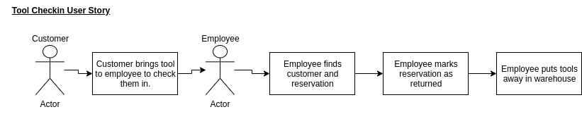
Track Inventory Requirement
FURPS
Functionality
MOSCOW
Must
It is necessary to create a method to track inventory. This includes adding tools to inventory, removing tools, adjusting on-hand quantity, and tracking how many tools are in the warehouse and how many are out due to a reservation.

Slide 6
Scrum Meeting Notes
Our first scrum meeting that was dealing with development tasks included heavy discussion on inventory tracking. We knew we must create a way to effectively track inventory.
There would be an items database that would hold each item. This database held fields for the item description, the items quantity, and notes specific to the items location in the Neighborhood Tool Co-op warehouse.
Tasks for this objective included:
Create items and remove items as as admin user - Brett
Change items quantity as an admin user - Brett
Display on-hand item amounts to all users - Brett

Slide 7

Admin User Creating Reservation Video

Slide 8
Admin User Checking in Reservation Video

Slide 9
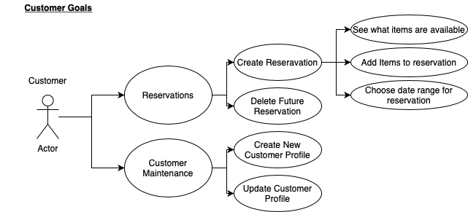
Customer Management Requirement
FURPS
Functionality
MOSCOW
MUST
It was necessary to allow both admins and users to manage customer accounts. Customer accounts must be able to be created, updated, and deleted.

Slide 10
Scrum Meeting Notes
Creating customer accounts was another topic covered in the first scrum meeting.
The database will have a user table in the database. Along with customer information like name, address, and phone, this table also included the customer email and encrypted password for their login information
The following tasks were created for this requirement:
Customers can create their accounts on the webpage - All
Customers can update their account information - All
Admins can create user accounts - All
Admins can create admin accounts - Zach
Admins can update and delete user accounts - Zach
Track user fees and delinquent accounts - Zach

Slide 11
Creating User Video

Slide 12
Customers make their reservations Requirement
FURPS
Functionality
MOSCOW
MUST
A customer must be able to make their own reservations on the webpage. A customer must have access to a list of the tools and their on-hand quantity. They must be able to create reservations, view their reservations, and cancel if the reservation is no longer needed.

Slide 13
Scrum Meeting Notes
Allowing Customers the ability to create their own reservations was discussed and planned half way through development.
The following tasks were needed for this requirement:
Create database structure for reservations (shown in next slide)
Views for reservations with date filter - Cade
Pages to supplement reservations - Eric
Create reservation - Brett
Check if tools available
Assign to user

Slide 14
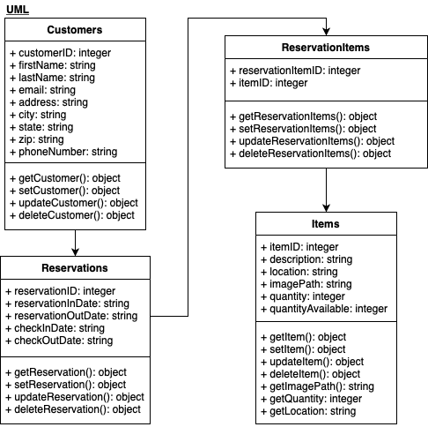
Database structure
Customers/Users table
Reservations
Reservation Items
Items

Slide 15
Database Structure Explained
When a reservation is created in the database, it is linked to a customer. The reservation table holds the information for the reservation dates as well. The reservation items table is the linking table between reservations and items. This allows for reservations to have multiple items and for items to be linked to a reservation without being tied to a specific reservation. This lets the same item be on multiple reservations as long as there is enough stock for the time frame given. Items is a table that holds the information specific to an item.

Slide 16
Customer Creating Reservation Video

Slide 17
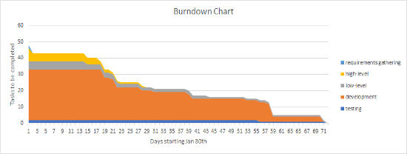
Burndown Chart

Slide 18
Sources
Hypertext Preprocessor. (n.d.). Retrieved April 11, 2020, from https://www.php.net/Laravel. (2020, April 9).
laravel/laravel. Retrieved April 11, 2020, from https://github.com/laravel/laravel
Resources for developers, by developers. (2020, April 7). Retrieved April 11, 2020, from https://developer.mozilla.org/en-US/
The PHP Framework for Web Artisans. (n.d.). Retrieved April 11, 2020, from https://laravel.com/
Where Developers Learn, Share, & Build Careers. (n.d.). Retrieved April 11, 2020, from https://stackoverflow.com/

Slide 19
Questions?

